Slide 1

Credit One
Customer Credit Default Risk Analysis

Slide 2
Customer loan defaults have increased at an alarming rate over the past year. Unless we can more effectively identify key attributes that can predict a customer’s probability of default, Credit One stands to lose clients. The Data Science team, through the application of analytics tools and a disciplined framework, is committed to designing and implementing a creative, and empirically sound solution to put into production. This report will detail the Data Science process, data sourcing and management, and our plan of attack for any issues that might arise.
Project Goals and expectations

Slide 3
The Framework
Define the goal
Collect and manage data
Build the model
Evaluate and critique the model
Present results and document
Deploy and maintain the model
Business critical problem solving is an iterative process by nature. A well-defined data science process framework is crucial to the success and longevity of any risk management model.

Slide 4
The Data Sources
Credit One is an external client and maintains their customer data in their own SQL database. We will access their database using the server ID the client provided and connect to their MySQL instance. We will then use a SQL “select” statement and write the data into a Pandas dataframe.
Once the data has been extracted to the Pandas dataframe we imported the ‘default_of_credit_card_customers.csv’ into our Jupyter Notebook to begin the data engineering process.
*Note- relevant, large data sources can be hard to come by making GitHub a great repository resource.
For this project we will be accessing Credit One’s MySQL database to retrieve customer demographics and payment information.

Slide 5
Data Management
We will utilize a well-defined data science process framework to pre-process the dataframe we retrieved without compromising the integrity of the data.
Ensure column labels are correctly represented
Sort columns containing numerical values in descending order to easily identify non-numerical data that should be dropped from the data set.
Select only desired rows and columns using the iloc function and save into a new dataframe object.
Check for and drop any ‘null’ values. *Note -Importing data using read_sql rather than read_csv opens the door for undesirable characters to appear that might otherwise be classified as ‘NaN’, requiring a reclassification code to be run.
Remove any duplicates that might be present in the data set.
Check data types among the features to ensure they are represented accurately. *Ex. Columns with numbers should be converted to ‘integers’ if represented as anything other than “dtypes: int64”.
Utilizing the 'SELECT * FROM credit’ retrieves raw customer credit default data that needs to be explored and conditioned before modeling and analytics tools can be applied.

Slide 6
Managing Data Issues
There is an understanding in Data Science that once a model has been built and it comes time to evaluate and critique the model, the author might have to back up a few steps and re-engineer the model by making adjustments to the data format or the scientific tool to derive meaningful insight in which to present and place the model into production.
The data process frameworks are iterative by nature.

Slide 7
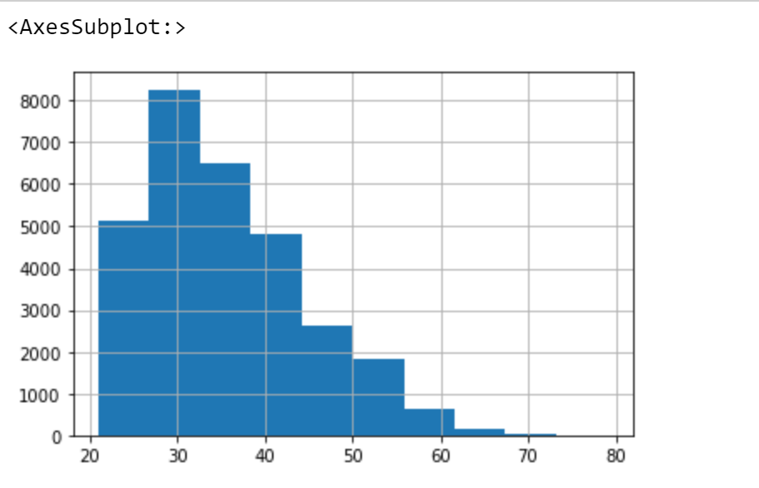
Initial Insights
Sex: There are more women customers than men in this data set – approximately 60:40 split
Education: 82% of customers had college educations.
Marital Status: 99% of the customers are either single or married; 53% of customers are single
Age: Most customers are between the ages of 25-35 years.
Upon initial examination of the data we have determined customer demographics that will play into pattern recognition when it comes time to predict default rates based on payment trends.

